Slide 1
Spring Data Jpa

Slide 2

Spring Data Jpa

Slide 3
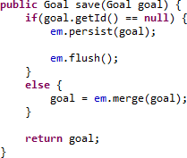
Updates
Persist is just used for Creates
Merge is used for updates
Save methods are usually overridden to handle both

Slide 4
Spring Data Jpa
A wrapper for Jpa
□ Need to know JPA before you can use Spring Data Jpa
Replaces our Repository Tier
Extremely powerful and eliminates boiler plate code
Can be extended for additional functionality

Slide 5
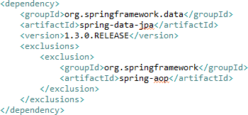

Maven
Need to add the spring-data-jpa jar
spring-data-jpa contains an incompatible transitive dependency
□ Exclude spring-aop

Slide 6
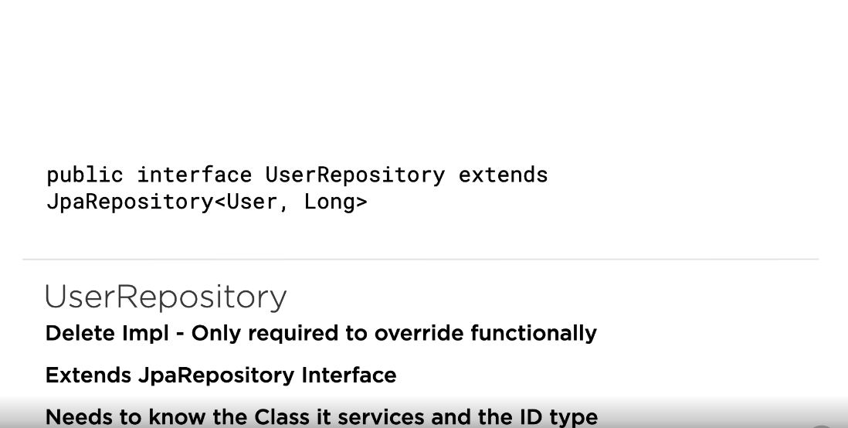

Slide 7
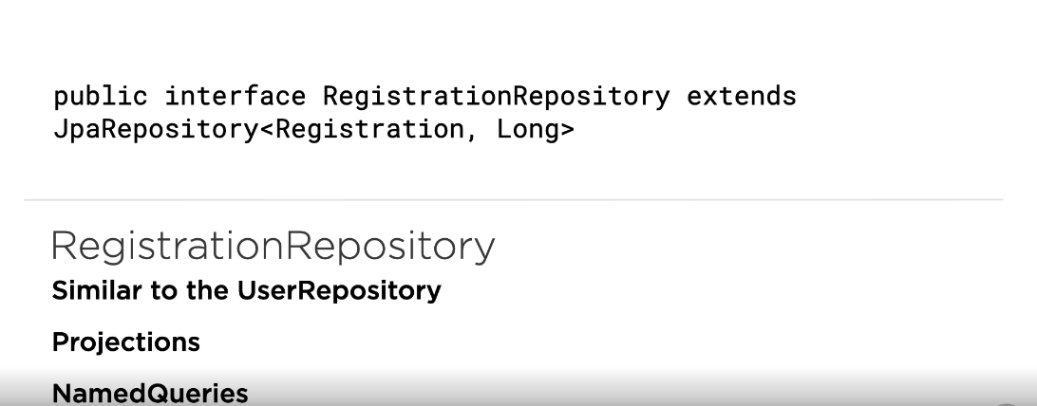

Slide 8
Jpa Namespace
To aid in configuring there is a Jpa Namespace

Slide 9

Exercise Repository
Delete Impl
□ The Impl is only required if we want to override functionality
Extends JpaRepository Interface
Needs to know the Class it services and the ID type

Slide 10
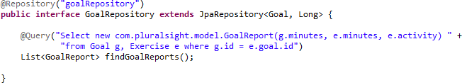
Goal Repository
Similar to the ExerciseRepository
No support for projections yet
□ Not needed though, just write a Query

Slide 11
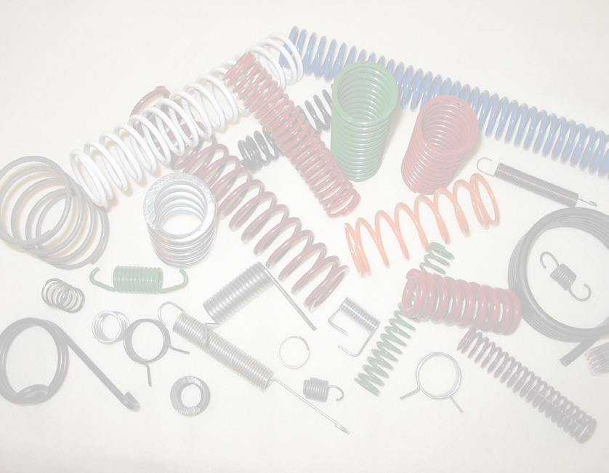
Summary
Spring Jpa Configuration
Update Example
Exercise Repository
Goal Repository

